Slide 1
Elite Cues and Mass Non-Compliance
80th Annual Midwest Political Science Association Conference Zachary P Dickson & Sara B Hobolt

Slide 2
Research Questions & Motivation
To what extent can elites motivate non-compliant behavior during the COVID-19 Pandemic?
Importance of elite cues during times of crisis
Survey experiments vis-a-vis real world data
Trump & incitement on January 6th, 2021

Slide 3
Background – what do we already know?
Elite cues have differential effects on adherence to social distancing in Democratic and Republican counties
Grossman et al. (2020b) show that US state governors’ were more effective at motivating social distancing behavior in Democratic-leaning counties than Republican-leaning counties
Bisbee and Lee (2022) show that reductive messages from President Trump play a similar role as objective information (COVID-19 cases/deaths) in influencing social distancing behavior
Non-compliance behavior?
How credible are partisan counterfactuals (e.g. Bisbee and Lee (2022); Grossman et al. (2020a))?

Slide 4
Research Design
We leverage the fact that Trump called for the “liberation” of three specific states (MN, MI & VA) on April 17, 2020
Data – mobility (Meta 2022) & arrests (FBI 2022)
Time horizon – state lockdowns

Slide 5
How were the messages received?
Note: Topic models include all quote tweets (143,171) of Trump’s LIBERATE tweets. A detailed description of text pre-processing and modeling methods are available in Appendix A.

Slide 6
Did the public respond?
Note: Google Trends data are normalized and scaled according to time period and geography in order to represent the relative popularity of a search term on a range between 0 and 100 (Google 2020).

Slide 7
Identification
Generalized Difference-in-Differences
Treatment group – Counties in states where Trump called for liberation
Control group – Counties in states where Trump did not call for liberation
Estimand = targeted cue
Time – State lockdowns
Threats to identification
Exclusion criteria – protests and other state level characteristics
Time-varying confounders – COVID-19 cases and deaths
Exogeneity assumption
Trump’s call for liberation not likely to be a response to local conditions (Appendix B)
Results – Mobility

Slide 8
 | Full State | Democratic Counties | Republican Counties
Treatment | 2.284* | 1.005 | 2.706**
 | (0.906) | (0.631) | (0.854)
Obs. | 29,064 | 6,132 | 22,932
R2 | 0.764 | 0.825 | 0.714
Full State | Democratic Counties | Republican Counties
-1.128* | -0.660 | -1.336**
(0.502) | (0.438) | (0.476)
29,064 | 6,132 | 22,932
0.883 | 0.904 | 0.869
(a) DV: Mobility
(b) DV: Stay-at-home Compliance

Slide 9
Note : + p < 0.1, * p < 0.05, ** p < 0.01, *** p < 0.001
Estimates are from two-way fixed effects models with county and time fixed effects. Standard errors are clustered by state and time. See Appendix D in paper for full results.

Slide 10
Dynamic Results – Mobility
Note: Matrix completion estimates and 95% confidence intervals. Estimates for the effect of Trump’s calls for Liberation on Mobility in Republican counties while using only Republican counties elsewhere as the control group.

Slide 11
Crime
We apply the same empirical strategy at the state level to arrests for crimes related to sentiment expressed in analysis of quote-tweets of Trump’s tweets
NIBRS data (FBI 2022) on arrests for Disorderly conduct; Assault (Aggravated and Simple); Destruction/Damage/Vandalism of Property
We use race as a crude proxy for partisanship
6% of black voters and 28% of Hispanic voters supported Trump in 2016
54% of whites, including 62% of white men
Generalized Difference-in-Differences
Treatment group – Arrests of whites in MN, MI and VA
Control group – Arrests of whites in states under local lockdowns (40 states)
Estimand = targeted cue
Matrix completion for inference (Athey et al. 2021)

Slide 12
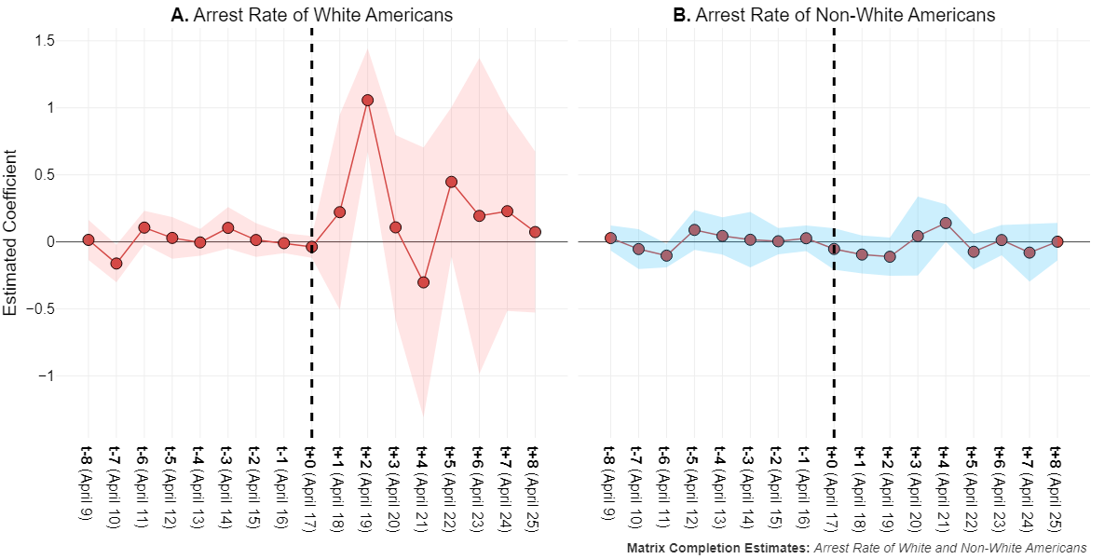
Results – Crime

Slide 13
Note: Matrix Completion Estimates and 95% Confidence Intervals. Arrests for Disorderly conduct; Assault (Aggravated and Simple); Destruction/Damage/Vandalism of Property.

Slide 14
Discussion & Concluding Remarks
Trump’s calls for liberation led to an increase in non-compliant behavior
The effects were concentrated in red counties (mobility) and among whites (crime)
Elite cues can motivate non-compliant behavior
We’ve seen this before (i.e. Jan 6th), but identification is challenging in observational data
Estimates are conservative given control groups
Limitations & directions for future research
is our case (i.e. Trump/USA) unique?

Slide 15
Thank you!

Slide 16
Robustness
Mobility
Alternative measure of mobility – Google mobility data (Appendix E)
Retail & recreation, and Aggregate mobility
Alternative estimation strategy – first-difference (Appendix F)
Crime
No effect of cues on arrest rate of other races (Appendix I)
No effect of cues on arrest rate of entire state population (Appendix J)
Alternative measurement of arrests – Two-day moving average (Appendix K)
Alternative modeling strategy – TWFE with state & date fixed effects (Appendix K)

Slide 17
References
Athey, Susan, Mohsen Bayati, Nikolay Doudchenko, Guido Imbens, and Khashayar Khosravi. 2021. “Matrix Completion Methods for Causal Panel Data Models.” Journal of the American Statistical Association 116 (536): 1716–30.
Bisbee, James, and Diana Da In Lee. 2022. “Objective Facts and Elite Cues: Partisan Responses to Covid-19.” The Journal of Politics 84 (3): 1278–91.
FBI. 2022. “National Incident-Based Reporting System (NIBRS), Federal Bureau of Investigation.” https://www.fbi.gov/how-we-can-help-you/more-fbi-services-and-information/ucr/nibrs.
Google. 2020. “Google Trends: Search Term: “Liberate",” April. https://trends.google.com/trends/explore.
Grossman, Guy, Soojong Kim, Jonah M. Rexer, and Harsha Thirumurthy. 2020a. “Political Partisanship Influences Behavioral Responses to Governors’ Recommendations for COVID-19 Prevention in the United States.” Proceedings of the National Academy of Sciences 117 (39): 24144–53. https://doi.org/10.1073/pnas.2007835117.
Grossman, Guy, Soojong Kim, Jonah M Rexer, and Harsha Thirumurthy. 2020b. “Political Partisanship Influences Behavioral Responses to Governors’ Recommendations for COVID-19 Prevention in the United States.” Proceedings of the National Academy of Sciences 117 (39): 24144–53.
Meta. 2022. “Movement Range Maps.” https://data.humdata.org/dataset/movement-range-maps.

